Slide 1
Agentic AI – Pre Requisite - Overview
Wells Fargo Premier logo
Updated December 2025
© 2025 Wells Fargo Bank, N.A.

Slide 2
Prompt Engineering
Art & Science of designing effective queries or instructions to get desired responses. Better questions to get better answers
Avoid using vague prompts (“Improve the email” vs “Rewrite this email to sound more confident and concise when asking a stakeholder for feedback on a technical proposal”
Anatomy of Prompt
Persona -> What role ?
Instructions -> What should model do ?
Input Content -> Text to be processed
Format -> Output format requirements
Additional Information -> Context/Background
Categories of Prompt
Zero Shot -> No examples ; Uses existing knowledge
Few Shot ->Few examples to guide the model
Chain of thought -> Guide the model step by step
How to get better responses
Be clear
Offer context
Be specific
Iterate & Refine
Self reflection – Ask for model bias
Avoid unnecessary details
Evaluation Criteria
Accuracy –> Factually correct & knowing the source of information
Coherence –> Logically connected response
Bias

Slide 3
Prompt Engineering
Evaluation Techniques
Surveys & Interviews from users
Self critique the model
Better results by adjusting parameters
Temperature – For creativity
Max Tokens – For response
Top P – For Limiting top choices of most likely responses
Stop Sequence – Where to stop generating text
Prompt Design Strategy – Basis
Task
AI Model
Desired Output
Byproduct of Task Specific Prompt
Greater Accuracy
Fine-tuned control
Improved Performance
Better user experience
Prompt Template
“You are a financial analyst . Can you tell me the latest share price value of {companyname} ? “

Slide 4

Understanding Agentic AI
Large Language Models
Pre-trained
Tokens -> Smallest broken text unit that LLM processes
Vector – Array of numbers forming embedding
Embeddings – Numerical representation of tokens that forms semantic meaning
Agents
Input -> LLM -> Action -> Feedback -> Stop/Out
Perceive / Reason / Act / Learn
Characteristics -> Autonomous / Human-in-loop / Goal oriented
Composition -> Reasoning , Memory, Tools
Need for Memory
Non reusable Tools
Reusable Tools - Model Context Protocol ( MCP )
Server -> Provides functionalities
Client –> Called by Agent
Retrieval-Augmented Generation
Pull more current info
Reduce hallucinations
Retriever ( vector search ) & Generator ( LLM )

Slide 5
Environment Setup - Review
Review ability for all attendees to have working Python Virtual Environment
Also perform pip install of the “requirements.txt” & python-dotenv in personal machine
Review the creation of API Keys for all attendees

Slide 6
Program Flow
Pre-Work
Mandatory Learning
Pluralsignt/Degreed
Environment Setup – Office Hours
Python Virtual Environment
API Keys
Main Course
Module 1:
Understanding Langchain
Langchain Expression Language
Hands-on
Module 2:
Memory & State
Retrieval Augmented Generation
Hands-on
Module 3:
Understanding LangGraph
Hands-on
Module 4:
Understanding MCP
Agents with Tools
Human in the loop
Module 5:
Observability - Arize AI
Hands-on
Single Agent - Pattern 1 – Tool Use
Tools Required – Office Hours
Hands on - Usecase - Banking Insights Agent - given a user request (“What’s my available balance? “)
Single Agent - Pattern 2 - Reflection
Tools required – Office Hours
Hands on - Policy‑Compliant Email Drafting Agent — Generate a customer reply and self‑critique for compliance review. Iterate until quality ≥ threshold.
Single Agent - Pattern 3 - Planning
Tools required – Office Hours
Hands on - Card Eligibility & Next‑Steps Agent — user asks “Should I apply for a credit card?”
Capstone Project – Hands on & Evaluation

Slide 7
Next Step - Module 1 Self Learning
LangChain | https://app.pluralsight.com/library/courses/langchain-development/table-of-contents
LangChain Expression Language(LCEL) | https://www.youtube.com/watch?v=LzxSY7197ns
Note – Reference hands-on Python code will be made available via a personal Google Drive. Please avoid bringing that to Wells Fargo Network

Slide 8
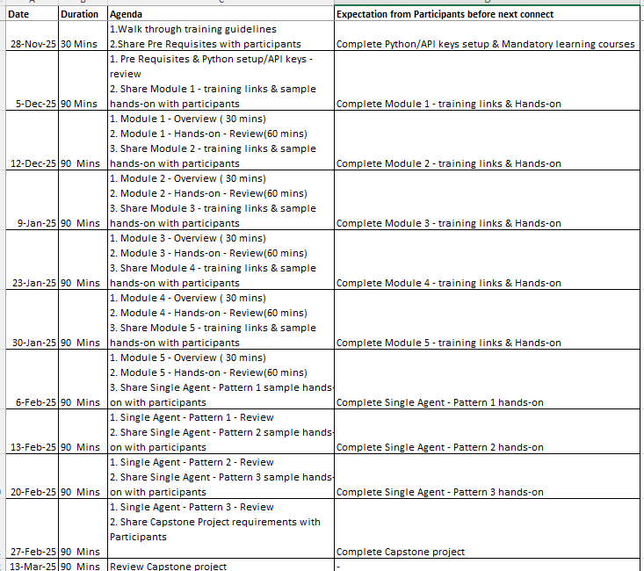
Overall Schedule

